Slide 1
Chapter 5
Congestion Control

Slide 2
DATA TRAFFIC
The main focus of congestion control and quality of service is data traffic.
In congestion control we try to avoid traffic congestion.
In quality of service, we try to create an appropriate environment for the traffic.

Slide 3
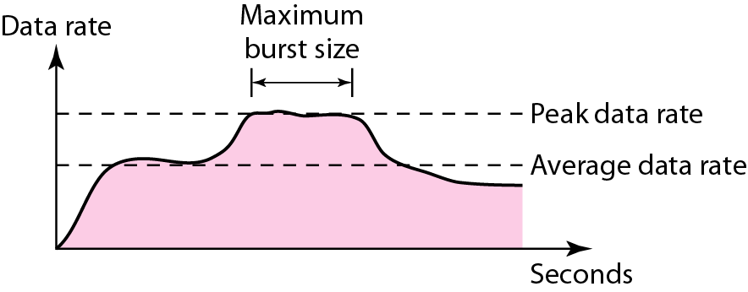
Figure Traffic descriptors

Slide 4
Traffic Descriptor
Traffic descriptors are qualitative values that represent a data flow.
Average Data Rate:
The average data rate is the number of bits sent during a period of time, divided by the number of seconds in that period.
We use the following equation:
Average data rate = amount of data/time
The average data rate is a very useful characteristic of traffic because it indicates the average bandwidth needed by the traffic.

Slide 5
Peak Data Rate
The peak data rate defines the maximum data rate of the traffic. In Figure it is the maximum y axis value.
The peak data rate is a very important measurement because it indicates the peak bandwidth that the network needs for traffic to pass through without changing its data flow.

Slide 6
Maximum Burst Size
Although the peak data rate is a critical value for the network, it can usually be ignored if the duration of the peak value is very short.
For example, if data are flowing steadily at the rate of 1 Mbps with a sudden peak data rate of 2 Mbps for just 1 ms, the network probably can handle the situation.
However, if the peak data rate lasts 60 ms, there may
be a problem for the network.
The maximum burst size normally refers to the maximum length of time the traffic is generated at the peak rate.

Slide 7
Traffic Profiles
For our purposes, a data flow can have one of the following traffic profiles:
1.Constant bit rate(CBR),
2.Variable bit rate(VBR), or
3.Bursty

Slide 8
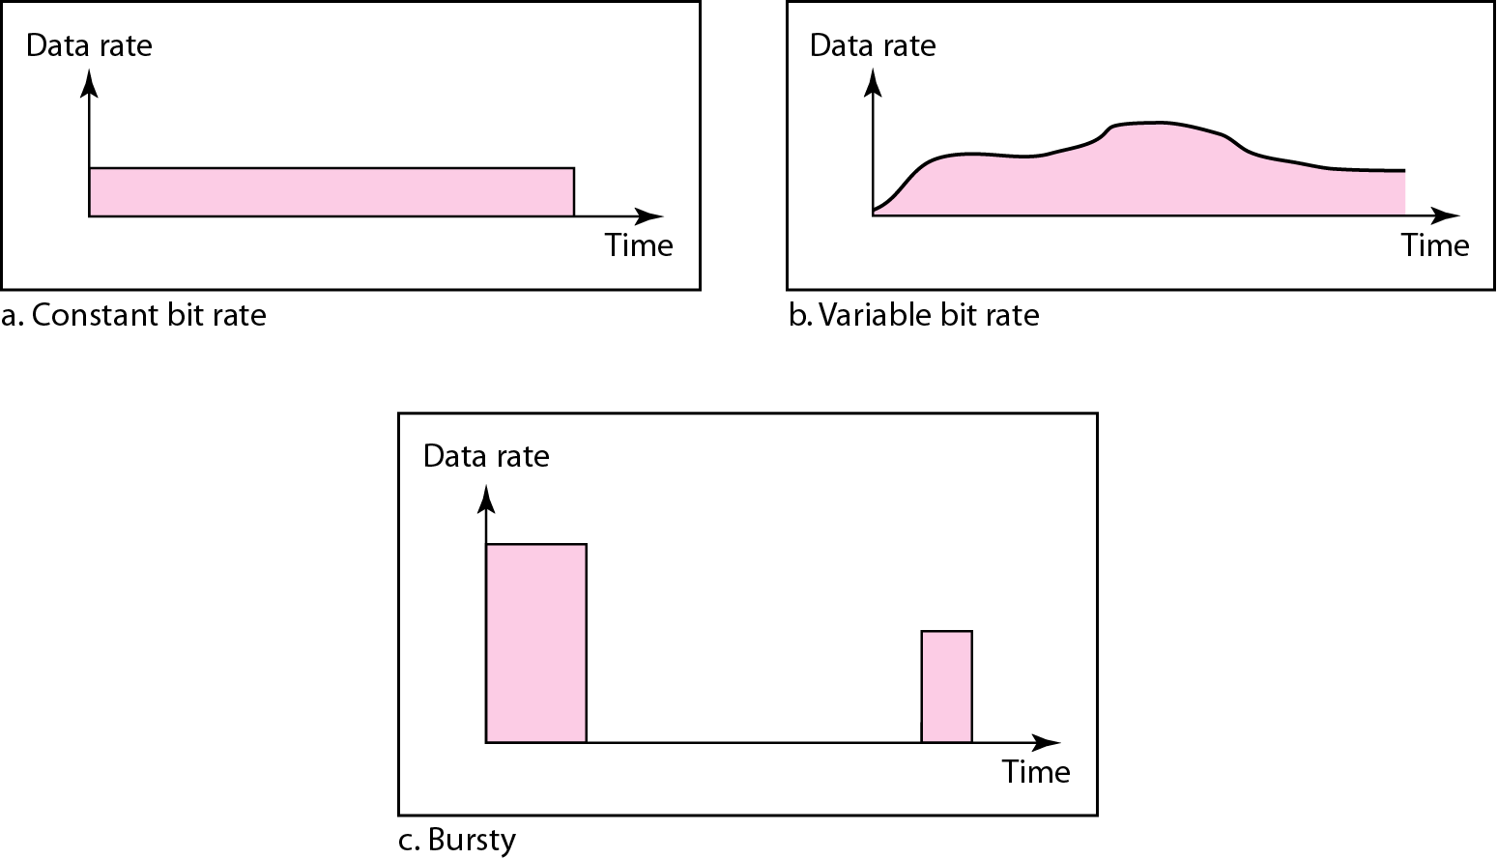
Figure Three traffic profiles

Slide 9
Constant Bit Rate
A constant-bit-rate (CBR), or a fixed-rate, traffic model has a data rate that does not change.
In this type of flow, the average data rate and the peak data rate are the same.
The maximum burst size is not applicable.
This type of traffic is very easy for a network to handle since it is predictable.
The network knows in advance how much bandwidth to allocate for this type of flow.

Slide 10
Variable Bit Rate
In the variable-bit-rate (VBR) category, the rate of the data flow changes in time, with the changes smooth instead of sudden and sharp.
In this type of flow, the average data rate and the peak data rate are different.
The maximum burst size is usually a small value.
This type of traffic is more difficult to handle than constant-bit-rate traffic, but it normally does not need to be reshaped.

Slide 11
Bursty
In the bursty data category, the data rate changes suddenly in a very short time.
It may jump from zero, for example, to 1 Mbps in a few microseconds and vice versa.
It may also remain at this value for a while.
The average bit rate and the peak bit rate are very different values in this type of flow. The maximum burst size is significant.

Slide 12
Bursty
This is the most difficult type of traffic for a network to handle because the profile is very unpredictable.
To handle this type of traffic, the network normally needs to reshape it, using reshaping techniques.
Bursty traffic is one of the main causes of congestion in a network.

Slide 13
Congestion
An important issue in a packet-switched network is congestion.
Congestion in a network may occur if the load on the network-the number of packets sent to the network-is greater than the capacity of the network-the number of packets a network can handle.
Congestion control refers to the mechanisms and techniques to control the congestion and keep the load below the capacity.

Slide 14
Congestion
As Internet can be considered as a Queue of packets, where transmitting nodes are constantly adding packets and some of them (receiving nodes) are removing packets from the queue.
So, consider a situation where too many packets are present in this queue (or internet or a part of internet), such that constantly transmitting nodes are pouring packets at a higher rate than receiving nodes are removing them.
This degrades the performance, and such a situation is termed as Congestion.
Main reason of congestion is more number of packets into the network than it can handle.

Slide 15
Congestion……
When the number of packets dumped into the network is within the carrying capacity, they all are delivered, expect a few that have too be rejected due to transmission errors .
As traffic increases too far, the routers are no longer able to cope, and they begin to lose packets. This tends to make matter worse.
At very high traffic, performance collapse completely, and almost no packet is delivered .

Slide 16
Causes Of Congestion
Congestion can occur due to several reasons. For example, if all of a sudden a stream of packets arrive on several input lines and need to be out on the same output line, then a long queue will be build up for that output. If there is insufficient memory to hold these packets, then packets will be lost (dropped).
If router have an infinite amount of memory even then instead of congestion being reduced, it gets worse; because by the time packets gets at the head of the queue, to be dispatched out to the output line, they have already timed-out.

Slide 17
All the packets will be forwarded to next router up to the destination, all the way only increasing the load to the network more and more.
Finally when it arrives at the destination, the packet will be discarded, due to time out, so instead of been dropped at any intermediate router (in case memory is restricted) such a packet goes all the way up to the destination, increasing the network load throughout and then finally gets dropped there.
Slow processors also cause Congestion. If the router CPU is slow at performing the task .

Slide 18
What is congestion? Why congestion occurs?
In a packet switching network, packets are introduced in the nodes (i.e. offered load), and the nodes in-turn forward the packets (i.e. throughput) into the network.
When the “offered load” crosses certain limit, then there is a sharp fall in the throughput. This phenomenon is known as congestion.
In every node of a packet switching network, queues (or buffers) are maintained to receive and transmit packets (store/forward network).
Due to busty nature of the network traffic there may be situations where there is overflow of the queues.
As a result there will be re-transmission of several packets, which further increases the network traffic. This finally leads to congestion

Slide 19
Effects of Congestion
Congestion affects two vital parameters of the network performance ..
Through put
Delay
Initially throughput increases linearly with offered load, because utilization of the network increases. However, as the offered load increases beyond certain limit, say 60% of the capacity of the network, the throughput drops.
If the offered load increases further, a point is reached when not a single packet is delivered to any destination, which is commonly known as deadlock situation.

Slide 20
Effects of Congestion
Congestion affects two vital parameters of the network performance ..
Through put
Delay

Slide 21
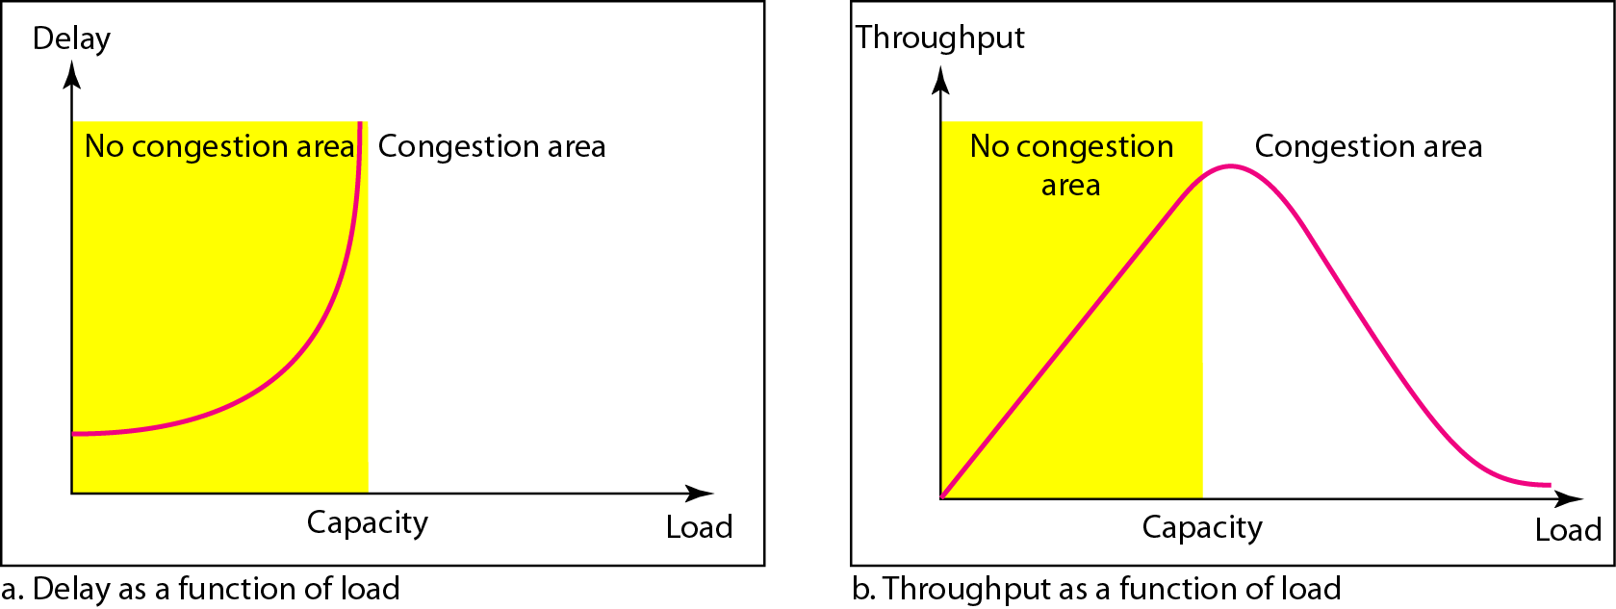
Figure Packet delay and throughput as functions of load

Slide 22
Delay Versus Load
Note that when the load is much less than the capacity of the network, the delay is at a minimum.
This minimum delay is composed of propagation delay and processing delay, both of which are negligible.
However, when the load reaches the network capacity, the delay increases sharply because we now need to add the waiting time in the queues (for all routers in the path) to the total delay.
Note that the delay becomes infinite when the load is greater than the capacity.

Slide 23
Delay Versus Load
If this is not obvious, consider the size of the queues when almost no packet reaches the destination, or reaches the destination with infinite delay; the queues become longer and longer.
Delay has a negative effect on the load and consequently the congestion.
When a packet is delayed, the source, not receiving the acknowledgment, retransmits the packet, which makes the delay, and the congestion, worse.

Slide 24
Throughput Versus Load
We can define throughput in a network as the number of packets passing through the network in a unit of time.
Notice that when the load is below the capacity of the network, the throughput increases proportionally with the load.
We expect the throughput to remain constant after the load reaches the capacity, but instead the throughput declines sharply.

Slide 25
Throughput Versus Load
The reason is the discarding of packets by the routers.
When the load exceeds the capacity, the queues become full and the routers have to discard some packets.
Discarding packet does not reduce the number of packets in the network because the sources retransmit the packets, using time-out mechanisms, when the packets do not reach the destinations.

Slide 26
Congestion Control Techniques
Congestion control refers to techniques and mechanisms that can either prevent congestion, before it happens, or remove congestion, after it has happened.
In general, we can divide congestion control mechanisms into two broad categories:
1.Open-loop congestion control (prevention)
2.Closed-loop congestion control (removal)
Open loop: Protocols to prevent or avoid congestion, ensuring that the system never enters a Congested State.
Close loop: Protocols that allow system to enter congested state, detect it, and remove it.

Slide 27
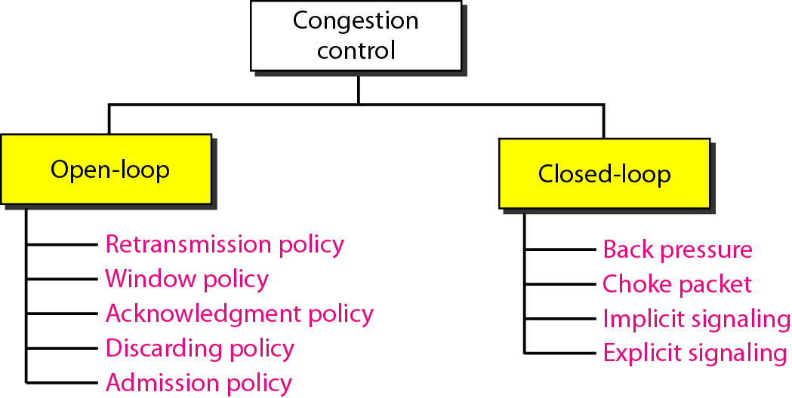
Congestion control categories

Slide 28
Open Loop rules or policies include deciding upon when to accept traffic, when to discard it, making scheduling decisions and so on .
Closed loop is based on the concept of feedback. During operation, some system parameters are measured and feed back to portions of the subnet that can take action to reduce the congestion. This approach can be divided into 3 steps:
Monitor the system (network) to detect whether the network is congested or not and what’s the actual location and devices involved.
To pass this information to the places where actions can be taken
Adjust the system operation to correct the problem.

Slide 29
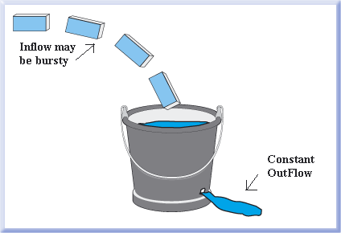
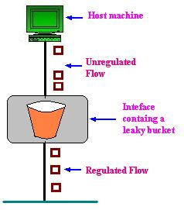
Open Loop Approach
1. Leaky Bucket Algorithm Consider a Bucket with a small hole at the bottom, whatever may be the rate of water pouring into the bucket, the rate at which water comes out from that small hole is constant. This scenario is depicted in fig. Once the bucket is full, any additional water entering it spills over the sides and is lost .
The same idea of leaky bucket can be applied to packets, as shown in Fig.
When the host has to send a packet, the packet is thrown into the bucket.
The bucket leaks at a constant rate, meaning the network interface transmits packets at a constant rate.

Slide 30
Leaky Bucket Algorithm
The Leaky Bucket Algorithm used to control rate in a network.
It is implemented as a single-server queue with constant service time.
If the bucket (buffer) overflows then packets are discarded.
In this algorithm the input rate can vary but the output rate remains constant.
This algorithm saves busty traffic into fixed rate traffic by averaging the data rate.

Slide 31
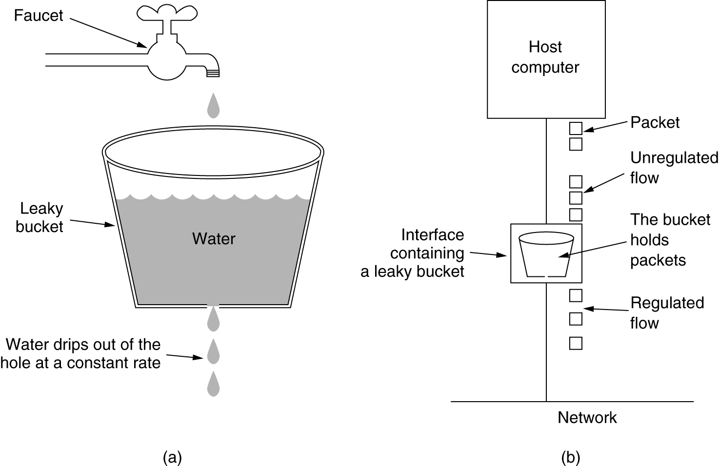
Leaky Bucket
(a) A leaky bucket with water. (b) a leaky bucket with packets.

Slide 32
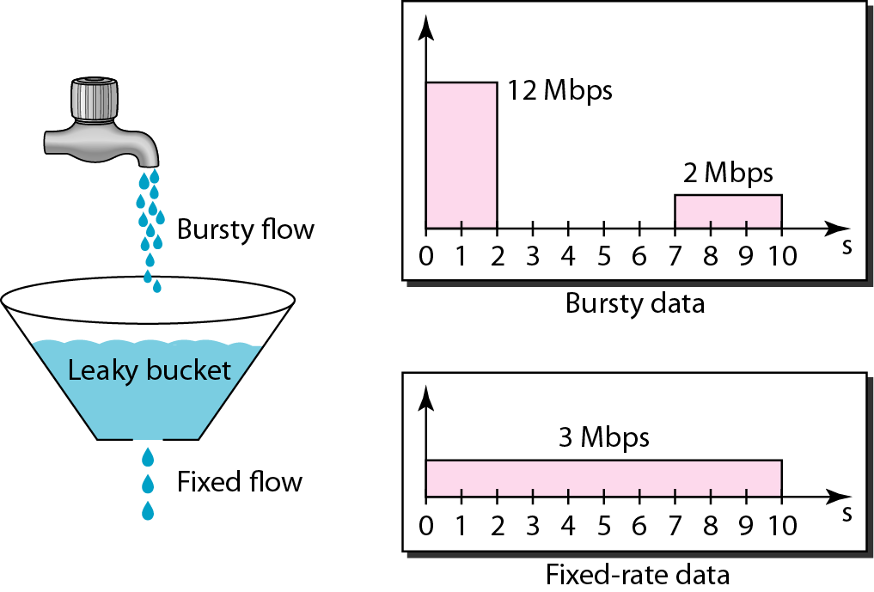
Figure : Leaky bucket

Slide 33
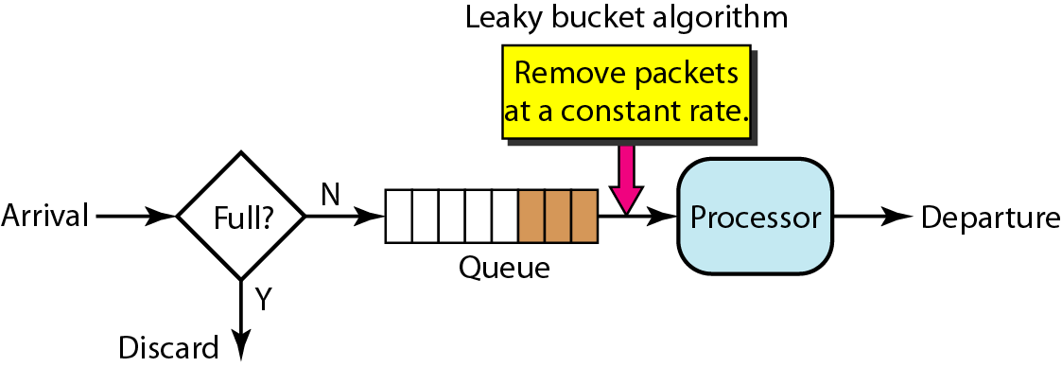
Leaky bucket implementation
A leaky bucket algorithm shapes bursty traffic into fixed-rate traffic by averaging the data rate. It may drop the packets if the bucket is full.

Slide 34
Leaky Bucket Algorithm
Algorithm
Step - 1 : Initialize the counter to ‘n’ at every tick of clock.
Step - 2 : If n is greater than the size of packet in the front of queue send the packet into the network and decrement the counter by size of packet. Repeat the step until n is less than the size of packet.
Step - 3 : Reset the counter and go to Step - 1.

Slide 35
Example
Let n = 1000
Packet = .
Since n > front of Queue i.e. n>200
Therefore, n= 1000-200 = 800
Packet size of 200 is sent to the network
Now Again n > front of queue i.e. n > 400
Therefore, n= 800-400 = 400
Packet size of 400 is sent to the network
Since n < front of queue .
There fore, the procedure is stop.
And we initialize n = 1000 on another tick of clock.
This procedure is repeated until all the packets is sent to the network.
200
700
500
450
400
200
200
700
500
450
400
200
700
500
450

Slide 36
Leaky Bucket Algorithm
Example
Consider a frame relay network having a capacity of 1Mb and data is input at the rate of 25mbps.Calculate
1. What is the time needed to fill the bucket.
2. If the output rate is 2 mbps , the time needed to empty the bucket.
Ans.
Here ,
C is Capacity of bucket = 1mb
Data input rate = 25 mbps
output rate = 2mbps.
1. T = C/input rate = 1/25 = 40 msec
2 T = C/output rate= ½ = 500 msec

Slide 37
2.Token Bucket Algorithm
For many applications it is better to allow the output to speed up somewhat when a larger burst arrives than to loose the data. Token Bucket algorithm provides such a solution.
In this algorithm token bucket holds token, generated at regular intervals. Main steps of this algorithm can be described as follows….
In regular intervals tokens are thrown into the bucket.
The bucket has a maximum capacity.
If there is a ready packet, a token is removed from the bucket, and the packet is send.
If there is no token in the bucket, the packet cannot be send.

Slide 38
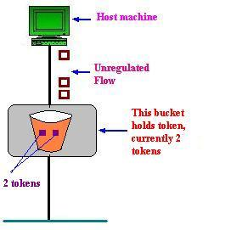
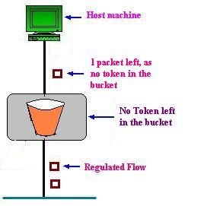
Figure shows the two scenarios before and after the tokens present in the bucket have been consumed.
In Fig. 1 the bucket holds two tokens, and three packets are waiting to be sent out of the interface.
In Fig. 2 two packets have been sent out by consuming two tokens, and 1 packet is still left.
Fig. 1
Fig. 2

Slide 39
Token Bucket Algorithm
The Token Bucket Algorithm compare to Leaky Bucket Algorithm allow the output rate vary depending on the size of burst.
In this algorithm the buckets holds token to transmit a packet, the host must capture and destroy one token.
Tokens are generated by a clock at the rate of one token every Δt sec.
Idle hosts can capture and save up tokens (up to the max. size of the bucket) in order to send larger bursts later.
The token bucket can easily be implemented with a counter. The token is initialized to zero.
Each time a token is added, the counter is incremented by 1. Each time a unit of data is sent, the counter is decremented by 1. When the counter is zero, the host cannot send data.

Slide 40
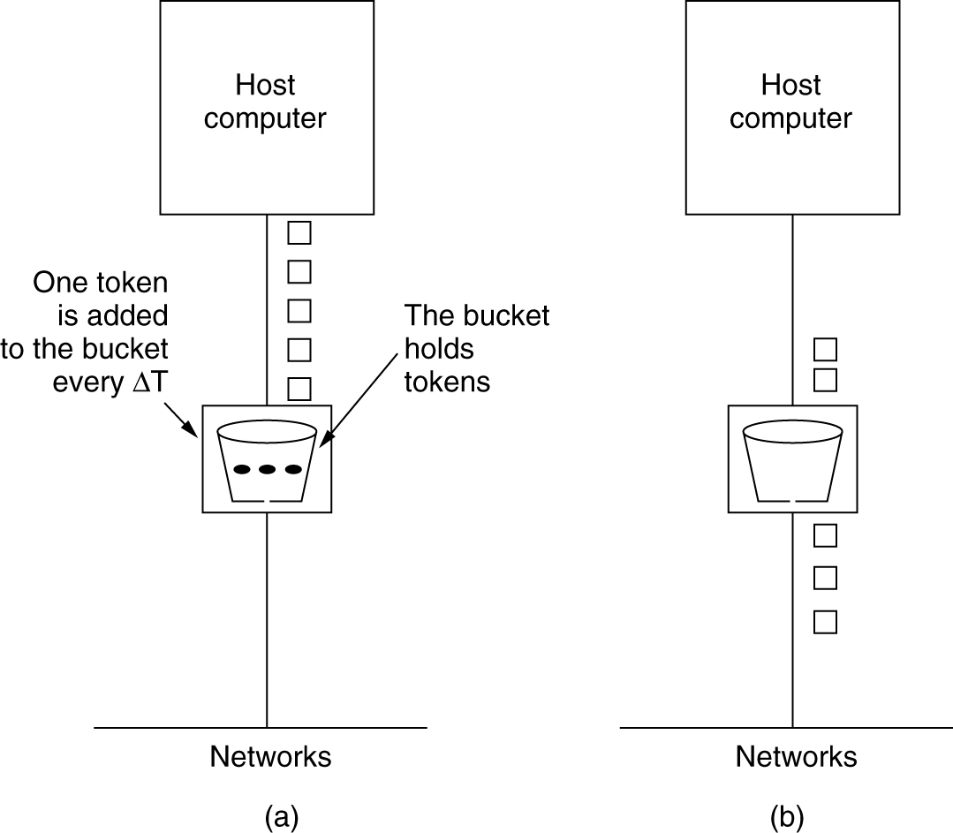
Token Bucket Algorithm
5-34
(a) Before (b) After

Slide 41
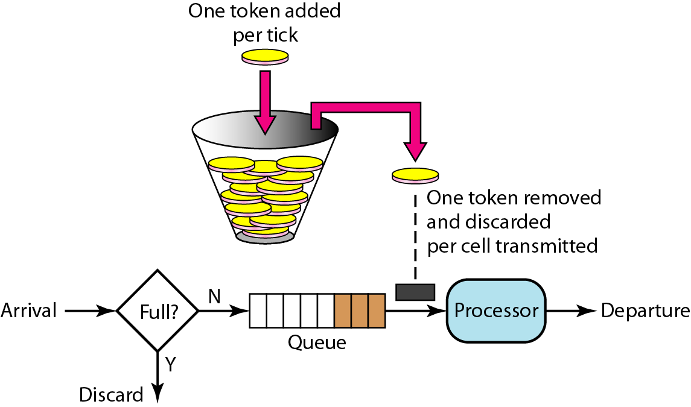
Figure : Token bucket

Slide 42
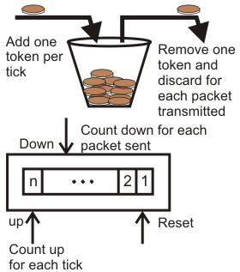

Slide 43
Token Bucket Algorithm
Algorithm
Step - 1 : A token is added at every ∆t time.
Step - 2 : The bucket can hold at most b-tokens. If a token arrive when bucket is full it is discarded.
Step - 3 : When a packet of m bytes arrived m tokens are removed from the bucket and the packet is sent to the network.
Step – 4 : If less than n tokens are available no tokens are removed from the buckets and the packet is considered to be non conformant.
The non conformant packet may be enqueued for subsequent transmission when sufficient token have been accumulated in the bucket.
If C is the maximum capacity of bucket and ρ is the arrival rate and M is the maximum output rate then Burst Length S can be calculated as
C + ρS = MS

Slide 44
Token Bucket Algorithm
Example
Consider a frame relay network having a capacity of 1Mb of data is arriving at the rate of 25mbps for 40msec.The Token arrival rate is 2mbps and the capacity of bucket is 500 kb with maximum output rate 25mbps.Calculate
1. The Burst Length.
2. Total output time.
Ans.
Here ,
C is Capacity of bucket = 500kb
M= 25 mbps
ρ = 2mbps.
1. S= 500/((25-2)*1000) = 21.73msec ~= 22msec
For 22msec the output rate is 25msec after that the output rate becomes 2mbps i.e. token arrival rate.
Therefore, for another 500 kb the time taken will be.
500/(2000) = 250 msec
Therefore, total output time = 22 +250 = 272 msec.

Slide 45
DIFFERENCE BETWEEN LEAKY BUCKET AND TOKEN BUCKET ALGORITHM
TOKEN BUCKET | LEAKY BUCKET
Token dependent. | Token independent.
If bucket is full token are discarded, but not the packet. | If bucket is full packet or data is discarded.
Packets can only transmitted when there are enough token | Packets are transmitted continuously.
It allows large bursts to be sent faster rate after that constant rate | It sends the packet at constant rate
It saves token to send large bursts. | It does not save token.

Slide 46
Choke Packet Technique
Each router monitors its resources and the utilization at each of its output line. There is a threshold set by the administrator, and whenever any of the resource utilization crosses this threshold and action is taken to curtail down this.
For Example, when source A receives a choke packet with destination B at first, it will curtail down the traffic to destination B by 50%, and if again after a fixed duration of time interval it receives the choke packet again for the same destination, it will further curtail down the traffic by 25% more and so on.

Slide 47
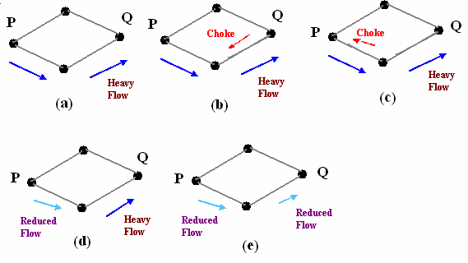
Depicts the functioning of choke packets, (a) Heavy traffic between nodes P and Q, (b) Node Q sends the Choke packet to P, (c) Choke packet reaches P, (d) P reduces the flow and send a reduced flow out, (e) Reduced flow reaches node Q .

Slide 48
Hop-by Hop Choke Packets
This technique is an advancement over Choked packet method.
At high speed over long distances, sending a packet all the way back to the source doesn’t help much, because by the time choke packet reach the source, already a lot of packets destined to the same original destination would be out from the source.
So to help this, Hop-by-Hop Choke packets are used. In this approach, the choke packet affects each and every intermediate router through which it passes by.
Here, as soon as choke packet reaches a router back to its path to the source, it curtails down the traffic between those intermediate routers. In this scenario, intermediate nodes must dedicate few more buffers for the incoming traffic as the outflow through that node will be curtailed down immediately as choke packet arrives it, but the input traffic flow will only be curtailed down when choke packet reaches the node which is before it in the original path.

Slide 49
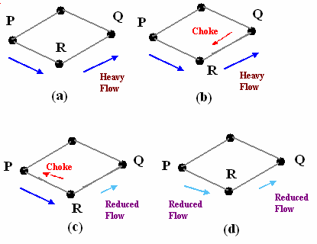
Depicts the functioning of Hop-by-Hop choke packets (a) Heavy traffic between nodes P and Q, (b) Node Q sends the Choke packet to P, (c) Choke packet reaches R, and the flow between R and Q is curtail down, Choke packer reaches P, and P reduces the flow out .

Slide 50
Load Shedding
It is one of the simplest and more effective techniques. In this method, whenever a router finds that there is congestion in the network, it simply starts dropping out the packets.
There are different methods by which a host can find out which packets to drop. Simplest way can be just choose the packets randomly which has to be dropped. More effective ways are there but they require some kind of cooperation from the sender too. For many applications, some packets are more important than others.
So, sender can mark the packets in priority classes to indicate how important they are. If such a priority policy is implemented than intermediate nodes can drop packets from the lower priority classes and use the available bandwidth for the more important packets.

Slide 51
How congestion control is performed by leaky bucket algorithm?
Ans : In leaky bucket algorithm, a buffering mechanism is introduced between the host computer and the network in order to regulate the flow of traffic.
Busty traffic are generated by the host computer and introduced in the network by leaky bucket mechanism in the following manner
* Packets are introduced in the network in one per tick
* In case of buffer overflow packets are discarded

Slide 52
In what way token bucket algorithm is superior to leaky bucket algorithm?
Ans : The leaky bucket algorithm controls the rate at which the packets are introduced in the network, but it is very conservative in nature. Some flexibility is introduced in token bucket algorithm.
In token bucket algorithm tokens are generated at each tick (up to certain limit).
For an incoming packet to be transmitted, it must capture a token and the transmission takes place at the same rate.
Hence some of the busty packets are transmitted at the same rate if tokens are available and thus introduces some amount of flexibility in the system. This also improves the performance.

Slide 53
What is choke packet? How is it used for congestion control?
Ans : Choke packet scheme is a close loop mechanism where each link is monitored to examine how much utilization is taking place.
If the utilization goes beyond a certain threshold limit, the link goes to a warning and a special packet, called choke packet is sent to the source.
On receiving the choke packet, the source reduced the traffic in order to avoid congestion.

Slide 54
Thank you

